Slide 1
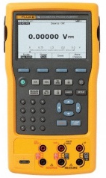
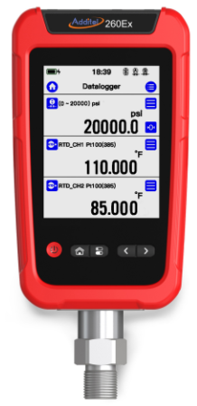
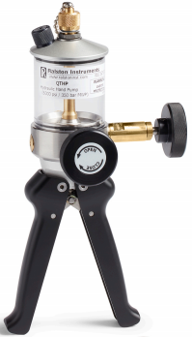
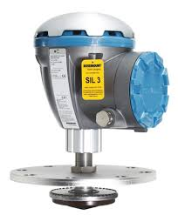
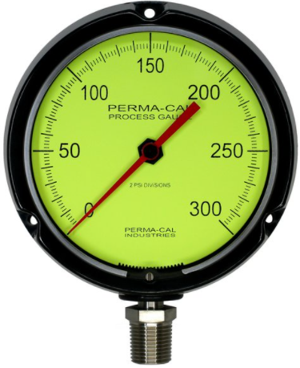
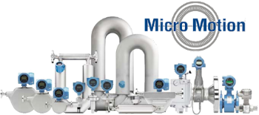
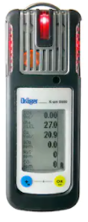
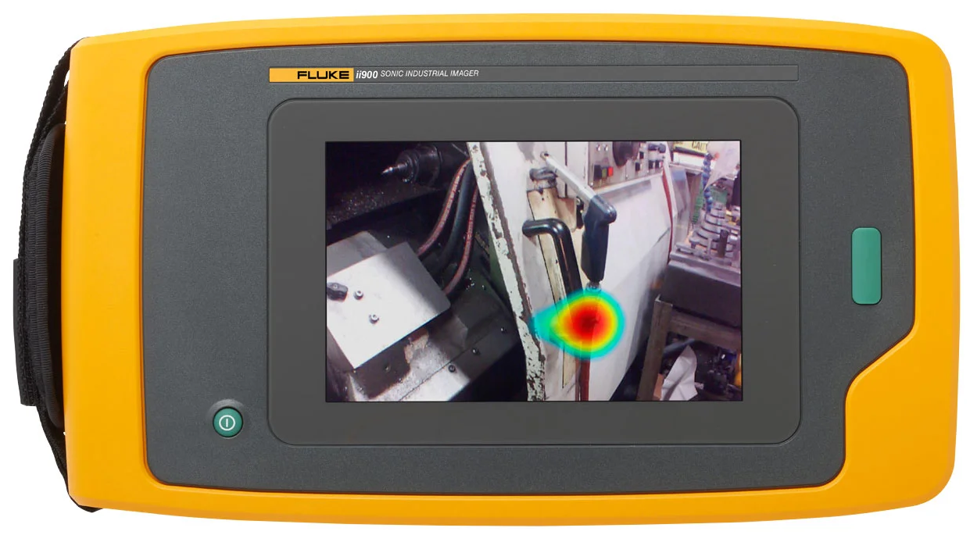
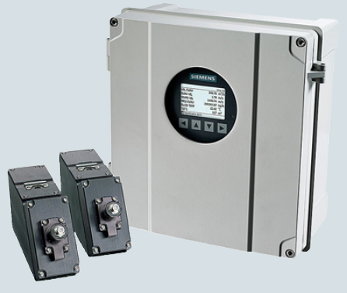
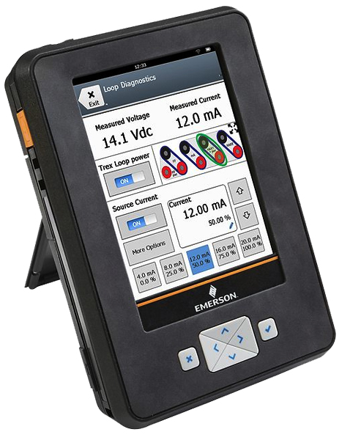
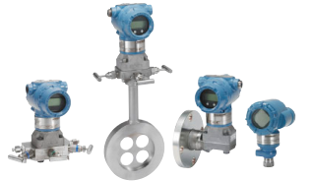
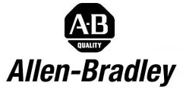
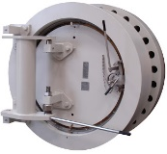
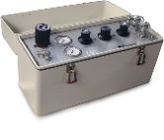
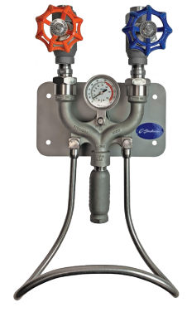
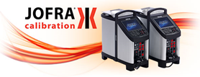
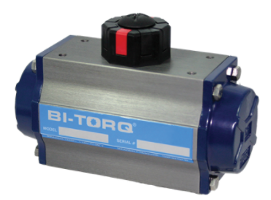
“Proven Equipment for the Oil and Gas Industry” – Sales and Consulting
FACTORY AUTHORIZED STOCKING DISTRIBUTOR FOR:
Crystal • Pie Calibrators • Fluke• Kelley Orifice Plates & Seal Rings • ThermoProbe • Ralston Hose, Pumps & Fittings
Pressure, Temperature, & Electrical Calibration Instruments
Advanced RTD Simulators
Smart Transmitter Capable,
Thermocouple Simulators
Loop Calibrators
Handheld Precision Digital Thermometers, Bluetooth Capability
Portable Electronic Tank Gauging Thermometers
Industry Leading Advanced Digital Pressure Calibrators & Digital Test Gauges, IS Ratings, Best Field Accuracy
Test Tools, Multimeters, Process Calibrators, Thermal Imagers, Infrared Thermometers
Adapters & Fittings, Calibration Test Pumps, Compressed Gas Control, Quick Test Hoses
Automatic Pressure & Digital Pressure Calibrators, Temperature Calibrators, Multifunction Process Calibrators, Bluetooth Capabilities
Digital Manometers &
Calibrators
Rotary Gas Meter Tester
Tank Gauging Systems • Level Gauges & Switches • Thermowells • RTD’s & Thermocouples • Analog Pressure Gauges
Radar Tank Gauging
Systems for Petroleum Liquids, Asphalt & LPG’s. High Precision
Meets API for Inventory Tank Control & Custody Transfer
RTDs, Thermowells, Multipoint Temp Probes Temp Transmitters
& Pressure Gauges
Bimetallic & Digital Thermometers, RTDs, Thermocouples, Thermowells,
Pressure Gauges & Transmitters
4-20mA Temp Transmitters
Coriolis & Density Meters • Ultrasonic Meters for Line Balancing & Leak Detection • Gas Detectors • Acoustic Imaging
Non-Intrusive Ultrasonic Flow Meters for Gas and Liquids. Check Metering. Leak Detection Systems, Interface Meters
Clamp-On, Portable
Single Gas Detectors
Multi-Gas Detectors
Benzene Detection
Personal Safety Equipment,
Respiratory Protection
Micro Motion Coriolis Flow & Density Measurement
Fluke ii900 Acoustic Imager
Compressed Air Leak Detection Time, Ensure Proper Air Pressure to Pneumatic Equipment
TREX• Bandlock Closures & Replacement Seals • Pressure Controllers • Pressure & Temp. Transmitters • Allen-Bradley
Bandlock™ 2 Quick-Opening Closure
Replacement Seals, Screws, Links, & Parts In Stock at Apex Instruments
AMS TREX Device Communicator:
Intrinsically Safe, 475 Replacement
Rosemount
Pressure, Temperature Transmitters, Manifolds
Limited Allen Bradley PLC Parts Are Available
Source Box 3000
Sampling Valves • Washdown Equipment• BI-TORQ Valve Automation • Orifice Plates • Silencers • Dry Block Calibrators
Piston Type Sampling Valves – Do Not Clog or Leak. Drain Valves – Ram Type Drain Valves, Air & Hydraulic, MG Process Valves: Spray & Rinse Valves. Bail, Gate, Piston, Specialty Valve Assemblies, Washdown Equipment , Bi-Torq Actuators
Universal & Paddle Orifice Plates to AGA 3 & API 14.3, From ½” to 36” Rings
Industrial Silencers, Engine Silencers, Vent Silencers, Gas Turbine Silencers, Intake Filters
Dry Block and Liquid Bath Temperature Calibrators. Portable, Accurate, Fast, Advanced Documenting Functions
303.804.0667 | sales@apex-instruments.com | www.Apex-Instruments.com | 7200 E. Dry Creek Rd. C102, Centennial, CO 80112

Slide 2
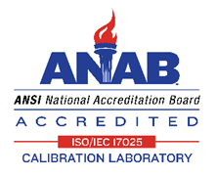
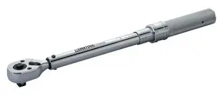
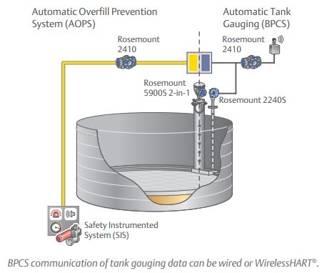
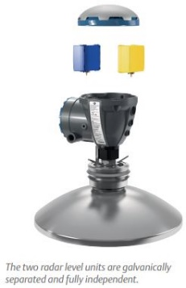
Calibration Services
In-House Calibration Laboratory For Pressure, Temperature, Electrical, & Torque Equipment
“Our Commitment Is To Accuracy, Reliability, & High Quality Service”
Pressure, Temperature, Electrical, & Torque Calibrations
Analog Pressure Gauges • Deadweight Testers • Digital Pressure Gauges • Pressure Calibrators • Pressure Modules (Ametek/ Crystal Engineering, Ashcroft/ Heise, Beta, Fluke) • Analog Thermometers • Digital Thermometers • Dry Block Calibrators • RTD Simulators • RTD Readers • Thermocouple Calibrators • Temperature Simulators • AC/DC Voltage and Current • Clamp Meters • Digital Multimeters • Loop Calibrators • Multi-function Calibrators
• 4 in. lb. to 250 ft. lb. Torque Wrenches • 60-600 ft. lb. Torque Wrenches •
Calibration Service’s Include
NIST Traceable Calibrations
ISO/IEC 17025 Accredited Calibrations (See scope for details)
Calibration Certificates with As Found / As Left Data
Calibration Label with Certified & Recertification Dates
Archiving of Historical Data
Prompt Turnaround (Typically Less than 1 Week)
Loaner Units Available (Depending on Availability)
Pick Up & Delivery Available
Repair of Instrument if Necessary
Calibration Seals where Applicable
Calibrations Up To 15,000 PSI
Automated Calibrations
Ensure High Accuracy Recertification
& Quick Turnaround
For More Information on Rates and Availability:
Call 866-276-2202 or Email Cal.Lab@Apex-Instruments.com
Download Our Calibration Order Form:
www.apex-instruments.com
TORQUE WRENCH CALIBRATIONS
FULLY TORQUED
Tank Gauge 2-in-1 Overfill Prevention Technology
MT
ND
Contact Your Local Sales Rep
 | Dave Noles 801-884-7014
 | Drew Behrend 307-259-5115
 | Joe Malara 303-210-7748
 | James Jaramillo 719-431-2079
 | Jason Boone 678-327-6446
 | Austin Molyneux 303-956-2445
ID
SD
WY
UT
NE
CO
KS
AZ
NM
OK
TX
Apex Instruments
7200 E. Dry Creek Rd. C-102
Centennial, CO 80112
Office: 303-804-0667
Email: sales@apex-instruments.com
www.apex-instruments.com
ISNetworld ® Compliance
Avetta (formerly PICS®Auditing) Compliance

